Slide 2
Cicero Update
Membership steady but some corporate reorganisation
Post covid meetings in Berlin and Edinburgh
Growth Circle
Maintaining contact with members in Russia and Ukraine
Work groups re-established
Online activity
Junior League
Next meeting Antwerp 17th -19th November 2022
Joint meeting next year

Slide 3
Industry Groups
Real Estate
Labour Law
Corporate
International Commercial Contracts
Intellectual Property
Dispute Resolution

Slide 5
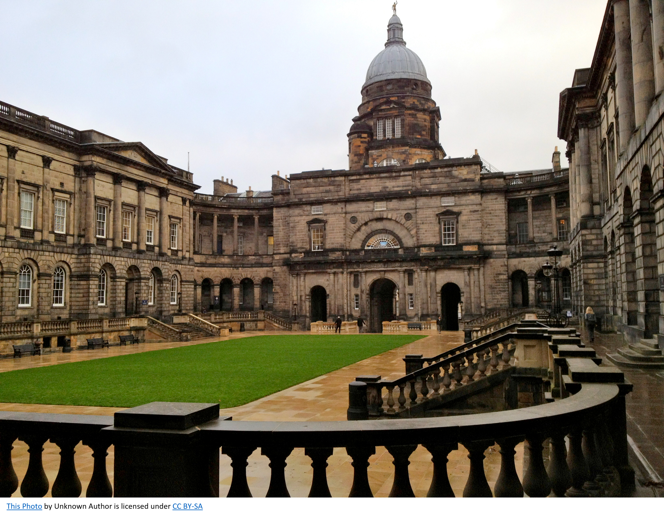

Slide 6
Who do we help?
Start ups
Science based consultancies
Universities
Public bodies - UK Space and Satellite
All our clients are IP rich but often cash poor

Slide 7
What do we do?
Corporate set up
Investment and fundraising
All types of commercial contract but usually with an IP twist
IP Strategy
Mediation
Workshop facilitation
Teaching

Slide 8
Funding Partnership
Loans $10 M upwards – no upper limit
12 year fixed term
Interest <3% and <2.5% green projects
No interest first 3 years
20-25% non depletion account under borrower’s control
No security
Subject to sanctions available globally

